Slide 1

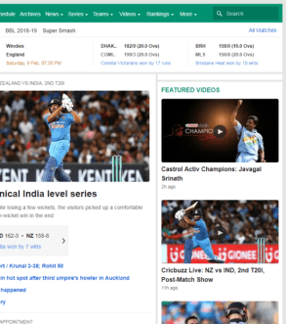
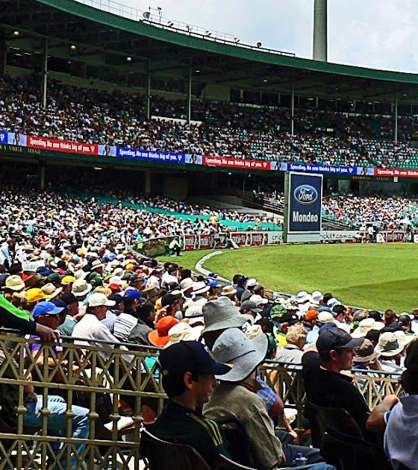
Highly available system for delivery of live game scores
Presented by -Namdev Patange
Guide
-Aniruddha Sarkar
This Photo by Unknown Author is licensed under CC BY-SA
This Photo by Unknown Author is licensed under CC BY

Slide 2

Requirements
1 Should show live Scores.
2 Should accept live Scores.
3 Should be highly available.
4 Multiple user access.
5 Low latency.

Slide 3
Literature review
1.Message Queue
2.Apache Kafka
3.Microservices
4.Mongo DB

Slide 4
1.Message Queue
A message queue is a form of asynchronous service-to-service communication.
Used in serverless and microservices architectures.
Messages are stored on the queue until they are processed and deleted.
Each message is processed only once, by a single consumer.

Slide 5

2.Apache Kafka
Apache Kafka is a distributed data store optimized for ingesting and processing streaming data in real-time.
Streaming data is data that is continuously generated by thousands of data sources, which typically send the data records in simultaneously.

Slide 6
3.Microservices
Microservices are an architectural and organizational approach to software development where software is composed of small independent services that communicate over well-defined APIs.
Streaming data is data that is continuously generated by thousands of data sources, which typically send the data records in simultaneously.

Slide 7

4.MongoDB
MongoDB has become one of the most wanted databases in the world because it makes it easy for developers to store, manage, and retrieve data when creating applications with most programming languages.

Slide 8
System Overview
Score Display App
Backend
Score Entry App
Score
Score

Slide 9

Systems Architecture
Microservices
Python
Score Inpute
Score Display
Mongo DB
Database
This Photo by Unknown Author is licensed under CC BY

Slide 10



1. “What is a Message Queue ?” https://aws.amazon.com/message-queue/
2. “What is Apache Kafka ?” https://www.confluent.io/what-is-apache-kafka/
3. “what is Microservices ?’’ https://microservices.io/
4.“what is MongoDB ?” https://www.mongodb.com/what-is-mongodb
Reference :

Slide 11

Thank you !

